Slide 1
Eco-Tourism Cloud Platform
(Etcp)

Slide 2
UEID Design Standards
Consistency
Use the same layout, colors, fonts, and icons throughout the platform.it easier for users to understand and use the site, it is smooth and familiar experience on every page
Accessibility
Good color contrast so text is easy to read.Works with keyboard shortcuts and screen readers.Includes descriptions for images and icons
User-Centered Design
Built around what real users need and how they behave. Regular testing and feedback from users during development. Focuses more on how it works for the user than just how it looks

Slide 3
Tools, and Technologies
Design Tools
Figma Used for wireframing, UI design, and prototyping. Enables real-time collaboration with team members and stakeholders.
Adobe XD Useful for creating high-fidelity prototypes and interactive design testing.
Sketch
It's widely used for creating interfaces, icons, and web development.
Marvel
platform that supports wireframing, prototyping, user testing, and design handoff.

Slide 4
Research and Fact-Gathering Techniques
We used Google Forms to conduct user surveys, chosen for its accessibility, ease of use, and structured data collection capabilities.
The survey was designed to capture insights on navigation, visual appeal, platform functionality, and overall user satisfaction.
A mix of multiple-choice, Likert scale, and open-ended questions were used to gather both quantitative and qualitative feedback.
The target audience included eco-conscious travelers, tour organizers, and nature enthusiasts, aligning with ETCP’s core user base.
Outreach was done via email invitations, social media, and eco-travel forums to ensure a diverse demographic representation.

Slide 5
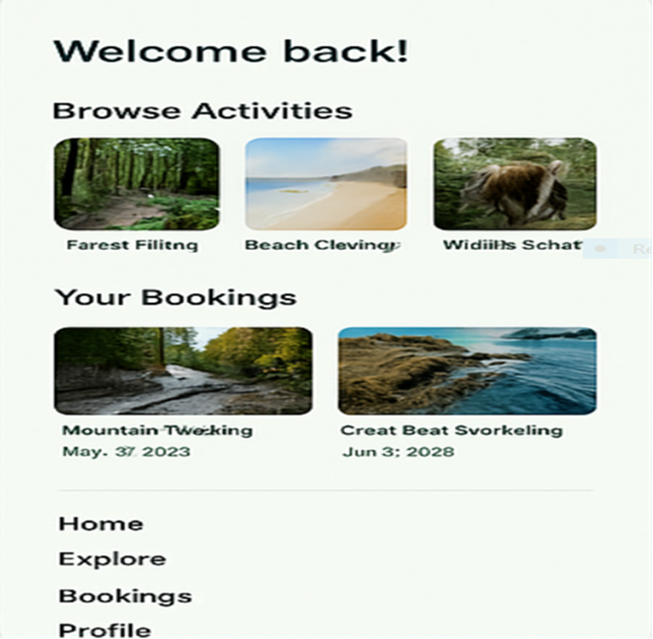
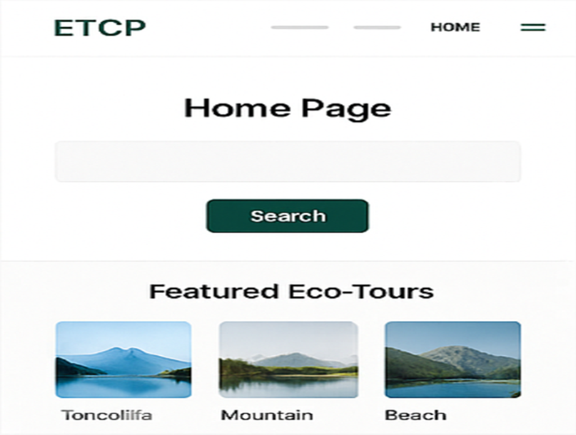

Slide 6
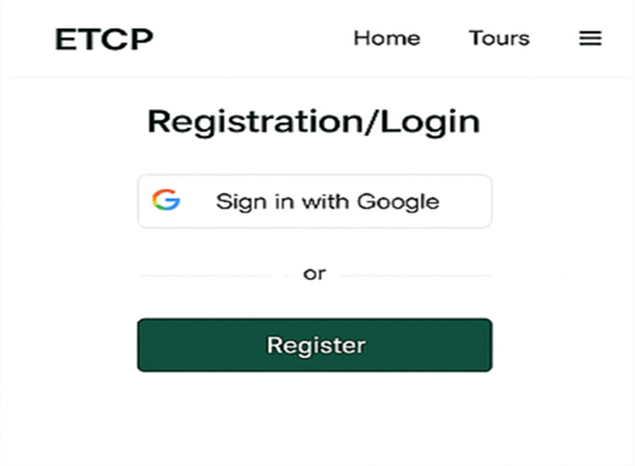
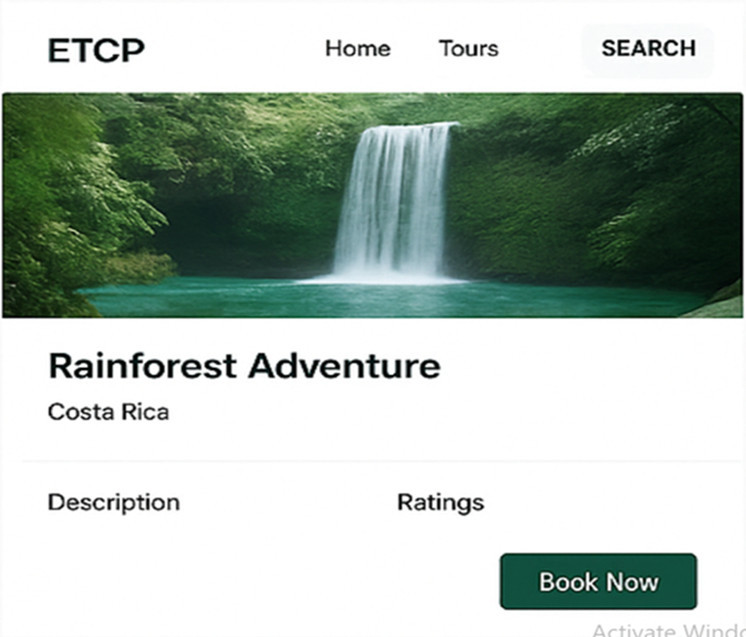

Slide 7
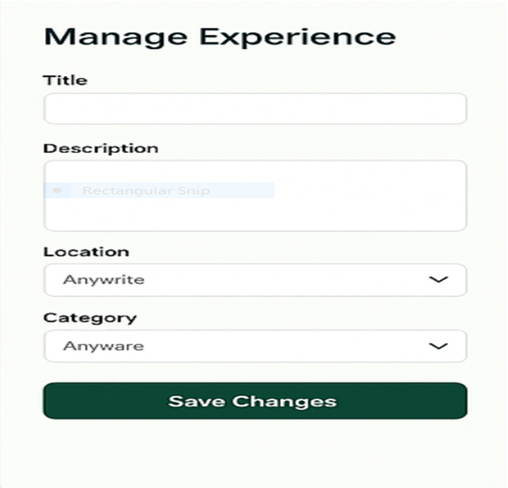
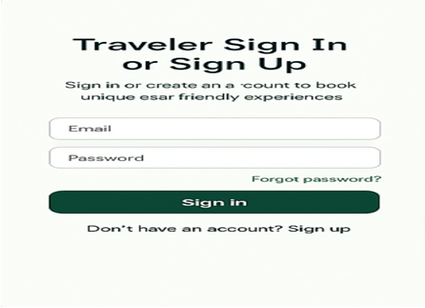

Slide 8
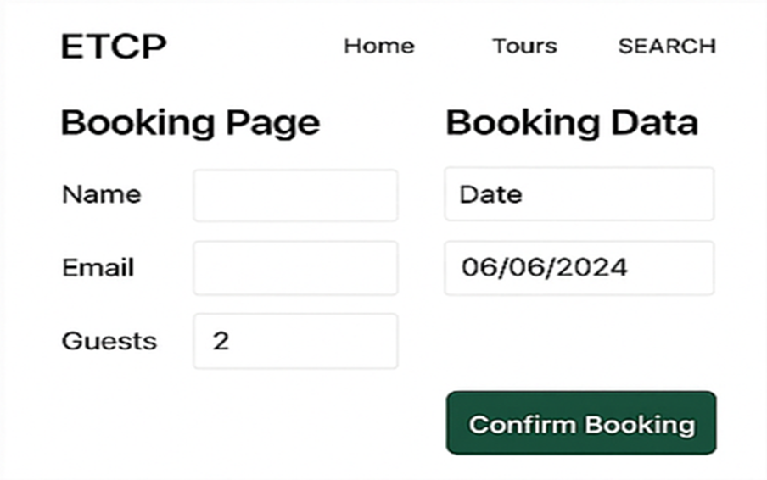
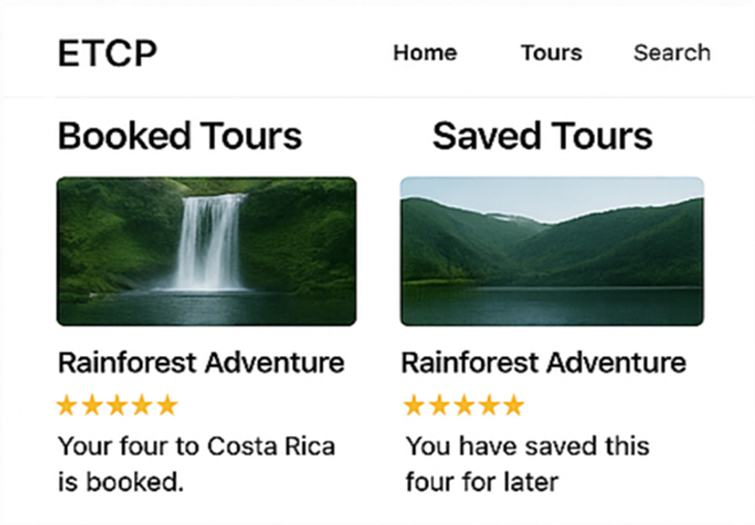

Slide 9
importance of continuous improvement
User feedback helps identify problems in the platform that may not be visible during design or development.
Users found the original layout confusing, so the updated design focused on simplicity and clarity.
These suggestions helped us make the platform more user-friendly, engaging, and visually appealing.
Regular updates based on feedback help keep the platform modern and aligned with current user needs.
Continuous improvement supports long-term success by improving user satisfaction and platform performance.

Slide 10

Future Enhancements with Visual Examples/Mock-Ups
Based on user feedback and testing insights, several future enhancements are planned to further improve the ETCP platform.
Introduce Personalized Tour Recommendations Use user behavior and past bookings to display eco-tour suggestions tailored to individual preferences.

Slide 11
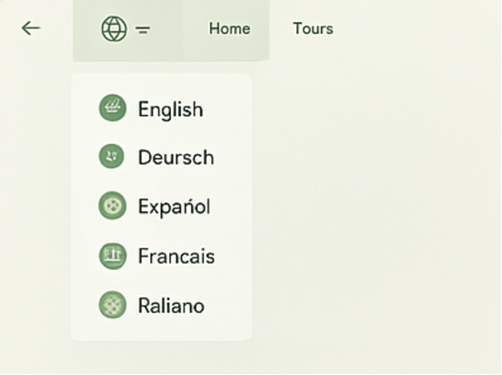
Multi-language Support To make the platform more inclusive, a language selector will be added in the header. This will support travelers from various countries.

Slide 12
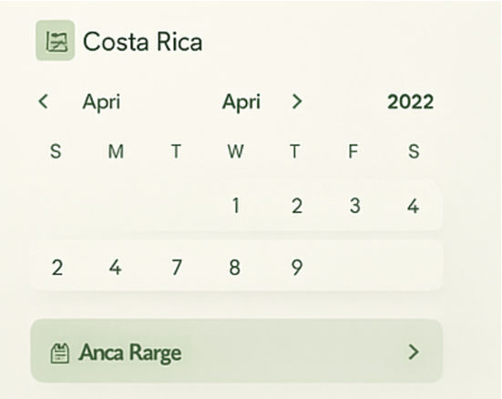
Interactive Booking Calendar Users will be able to view tour availability in a calendar format tours

Slide 13
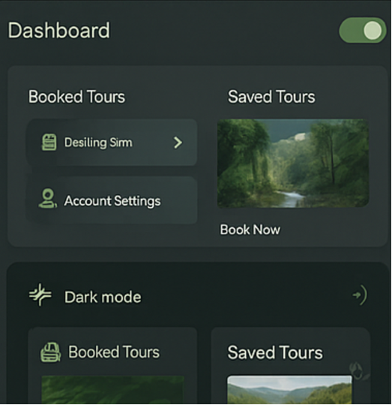
Dark Mode Feature Introduce a toggle switch for light/dark themes to improve accessibility and visual comfort during night-time browsing.

Slide 14
Conclusion
The ETCP platform has been designed with a strong focus on user experience, sustainability, and accessibility.
Through research, testing, and user feedback, we have created a cleaner, more intuitive interface that supports eco-conscious travel.
Iterative improvements based on real user input have helped refine the platform’s core features like booking, personalization, and dashboard navigation.
Proposed future enhancements aim to further improve user satisfaction, including quick-access tools, multi-language support, and interactive content.
Visual mock-ups clearly demonstrate how these features will integrate smoothly into the existing design.
Continuous improvement will ensure ETCP remains relevant, user-centered, and aligned with the needs of both travelers and eco-tourism providers.
ETCP is more than a travel platform it promotes responsible tourism and empowers users to make ethical travel choices.

Slide 15
Thank you

